Slide 1
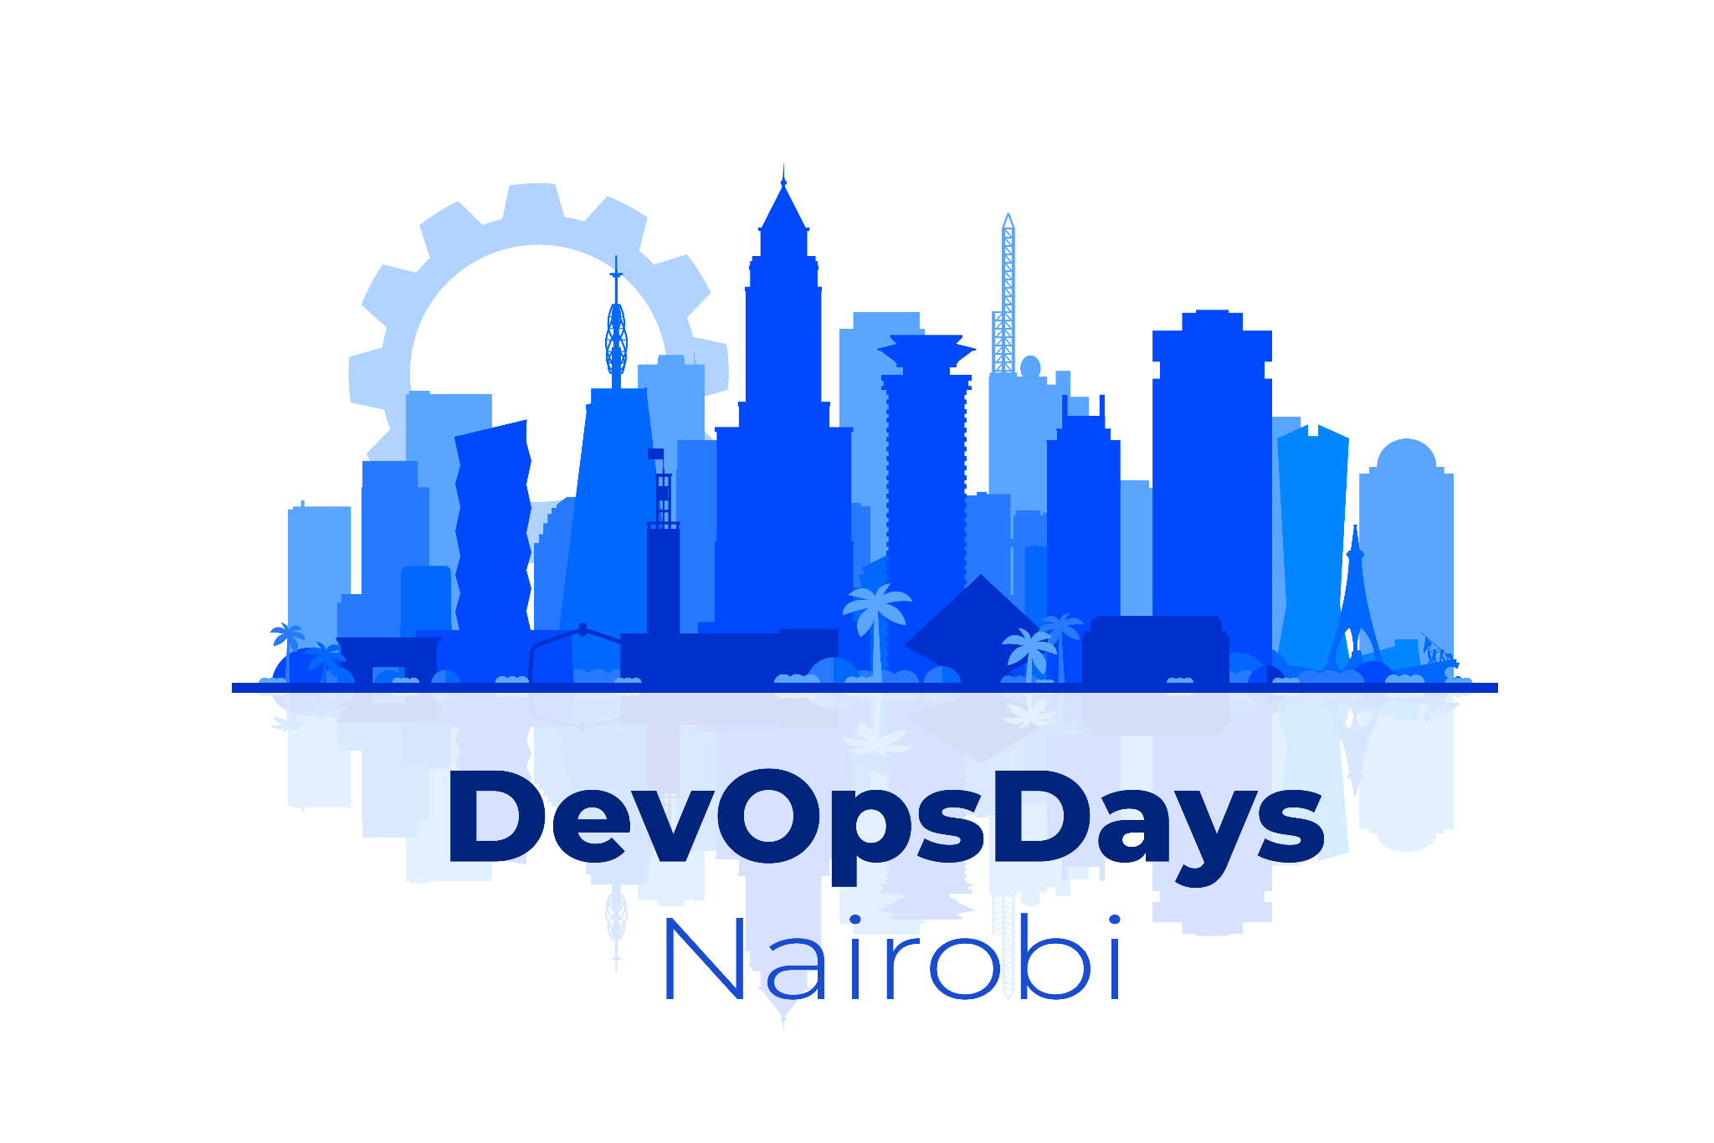
DevOpsDays Nairobi 2024
DevOps is my Culture, Agile is my Practice, Value is my Game

Slide 2
Agenda
DevOps is my Culture
Agile is my Practice
Value is my Game
Q&A
2024

Slide 3
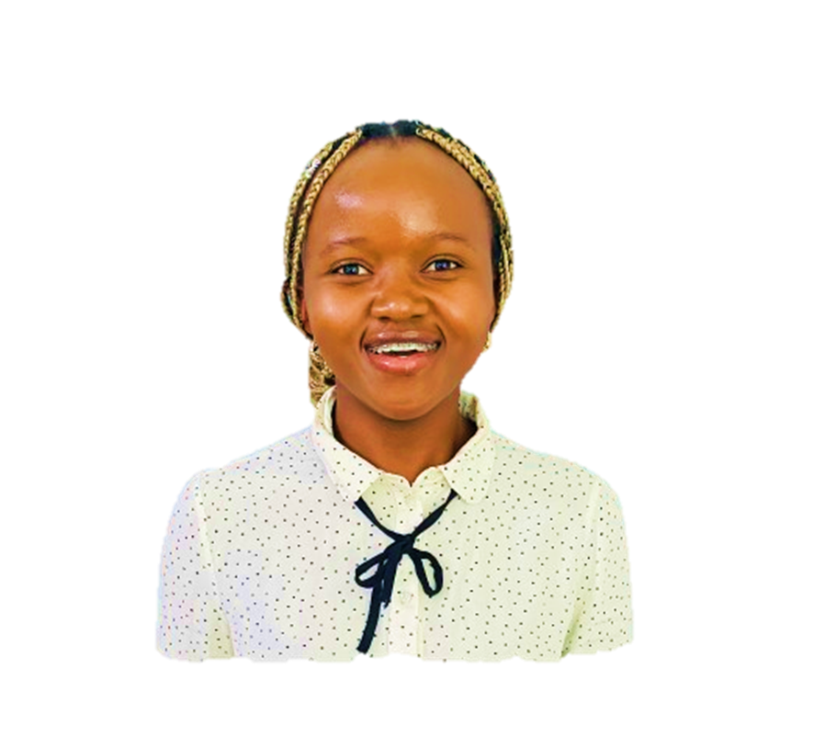
DevOpsDays Nairobi 2024
Linet Kendi
Infrastructure Technical Engineer with almost 4 yrs of experience in the tech ecosystems
Twitter ->@k_kiunga254
Kendi Blog’s on Hashnode Slina.hashnode.com
Open to Collaborations in cloud Infrastructure projects.
Love Hiking and adventure trails

Slide 4
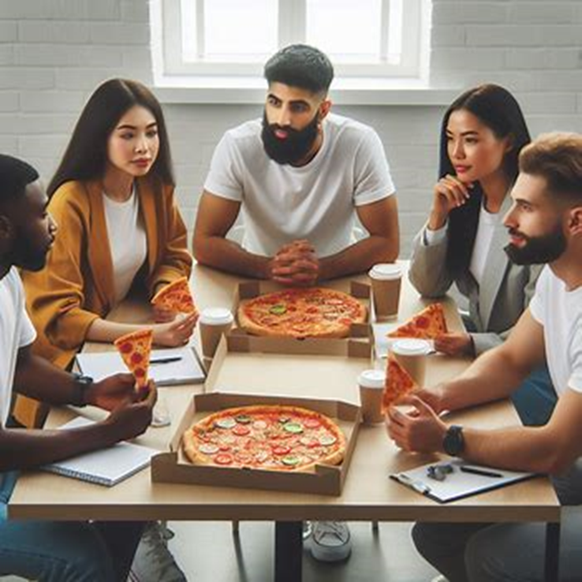
DevOpsDays Nairobi 2024
DevOps is my Culture
Case Study:
AWS - “Two-pizza team”
Image
Notes:
DevOps signifies a cultural shift towards collaboration, transparency, and continuous improvement, enabling teams to deliver high-quality software efficiently.
Cross Functional Collaboration: This is where both the developers and operations teams collaborate willingly to deliver value.
Self Service: Each member of the team needs to embrace change at a behavioral level to initiate and achieve culture change.
“If you want to change the world, start with yourself.”
―Mohandas Gandhi
Blameless Post mortems: This encourages teams to talk through what went wrong step by step and brainstorm ideas for improving. It embraces the culture of speaking from a pr-active learning point of view, instead of fear. It acknowledges all of use are human beings and are prone to error but embrace learning and change.
Concept of "the two - Pizza Team" - No team should be big enough that it would take more than two pizzas to feed them.
The "Two-Pizza Teams" culture fosters autonomy and accountability, enabling small, cross-functional teams to innovate and deliver value independently. It also ensures that the team do not suffer from the Ringelmann effect (a tendency for individual productivity to decrease in large groups. As team resources swell, there is less focus on individual effort as people lean more on others to shoulder the load). Amazon has had tremendous innovation/ growth and increased value for the customer through this model.
Single threaded focus - two-pizza teams are focused on just one service or offering, and just the customers who use it.
This single-threaded ownership extends across the full customer experience and the entire lifecycle (SDLC -engineering, testing, product and program management, operations) of a two-pizza team’s product or service.
With this focus a two-pizza team has the right resources embedded within them – engineering, testing, product and program management, operations, etc. – to help them own and run their service end-to-end.
Single-threaded leader, single-threaded ownership over a specific product or service –
As demand grows and the team grows, -the two – Pizza teams is split into smaller pizzas working on a single-threaded ownership
In the end - a two-pizza team isn’t solely about size as much as it is about fostering and pushing ownership and independence down to the team level – from ideation to execution, from ongoing operational improvement to constant product iteration and innovation.

Slide 5
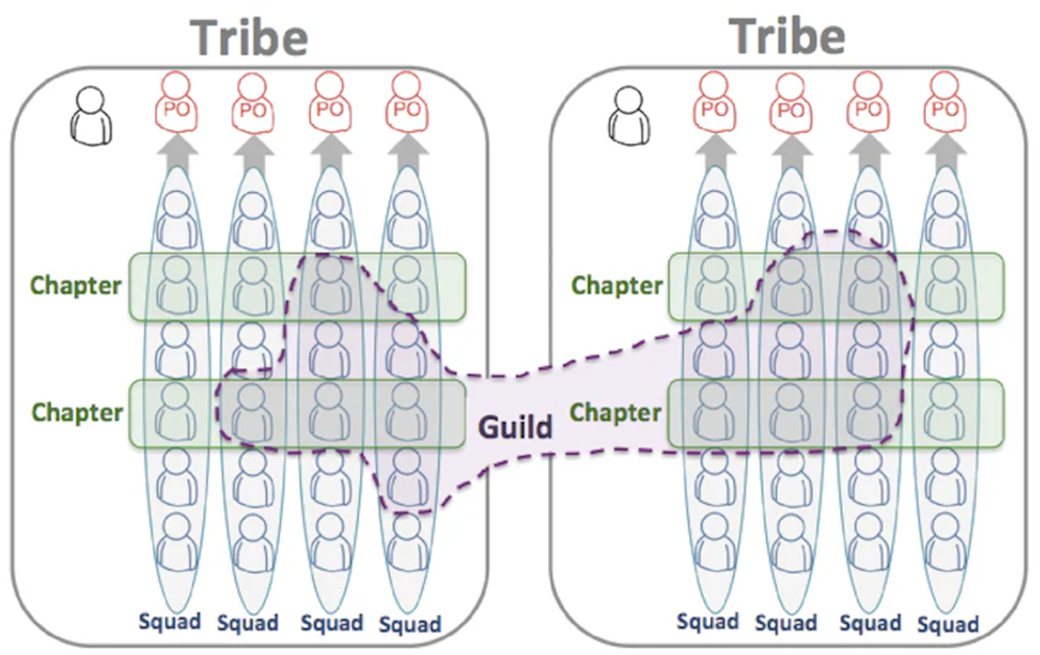
DevOpsDays Nairobi 2024
Agile is my practice
Case Study:
Spotify - “SQUAD MODEL”
Notes:
Agile methodologies serve as the practical framework for implementing DevOps principles, emphasizing iterative development, adaptability, and customer-centricity.
"Squad Model" that focuses on team autonomy and relies on people to reach objectives and complete goals.
Squad is like a mini-startup. It is the basic unit of the Spotify model. Squads are autonomous teams composed of 6 to 12 people working together on a specific feature area of the user experience. They are free to choose between any agile frameworks (Kanban, Sprints).
Each squad is assigned a mission, Product Owner and Agile coach
Tribes is like an incubator for the Squads. It is made up of multiple squads working together on related missions and features (sample features include Music Player/ backend infrastructure)
a maximum of 150 people and have a certain degree of autonomy but are placed under the authority of 1 or more tribe leads. Tribe leads are responsible for fostering teamwork and collaboration within the tribe and across the squads. Often tribes work in the same office space
Chapters is like a professor of the squads/ tribes. horizontal structures designed to regroup the specialist of a specific tool/area within a tribe. Act as backbone holding the squads together.
Role : ensure best-practices are established and followed by everyone working on a specific feature across the entire tribe. standards make for faster development cycles and easier interoperability
Leadership : Chapter Lead - guides the other members of the chapter and helps them grow their skills to become even better specialist. Reserved only for Specialist.
What if am not a specialist?
Guilds are like " a community of interest" they are transversal groups designed to facilitate exchange of solutions, knowledge sharing and to avoid time wastage (as a problem encountered by one tribe could have already been solved by another tribe). Consist of members of different tribes with a common interest (open to anyone).
Convene during workshops or hackathons.
Main purpose of a guild is to fosters self development and learning.
System wide roles – that cut across the organizations
System Owners (SO) - they focus on things like quality, documentation , technical debt, stability, scalability of infrastructure and release process.
Chief Architects - co-ordinate work on a high-level architecture issues that cut across multiple systems.
Spotify is one of the best successful implementation of agile, scaled to the size of a large business.

Slide 6
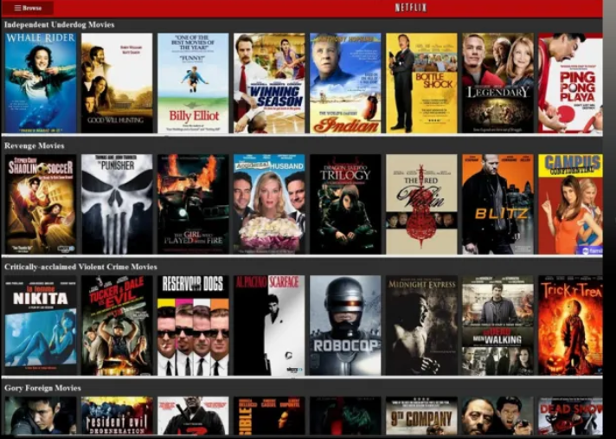
DevOpsDays Nairobi 2024
Value is my game
Case Study:
Netflix –
“Personalized Recommendations”
Notes:
the pursuit of value underscores the ultimate goal of delivering meaningful outcomes to customers and stakeholders, driving organizational growth and success.
Netflix's focus on personalized recommendations and seamless streaming experience demonstrates its commitment to delivering value to subscribers, driving customer satisfaction and retention.
Netflix's personalized streaming recommendations allow them to cache content on servers near the customers edge location leading to optimized cache quality and improved content quality.
internal pre-quality checks on the movies once received from the production houses to ensure they meet the Netflix standards before adding them to the catalogue.
competition for attention is high, Netflix is not only competing with other streaming services but also family time and the evolving social media apps that seem to take the world with a storm.
Coming up with Netflix “Fast Laughs” that is like Instagram reels/ TikTok videos.
Personalization starts from the homepage –
Quiz – Why does Netflix recommend me an animation movie or a movie with Pg13 rating while I’m grown up now? - important to note that the recommendations are based on the whole household ( for everyone to find some thing to watch) For a single household ( the concept lies to enable you explore your other interests and provide diversity in the content)
Personalized recommendations category:
Top 10 row ranking to find best possible ordering of a set of items for a member, within a specific context in real-time.
Genres - this Groups the content according to the themes of the movie i.e., action-themed movies, Romance
Facebook Connect - this features allows you to connect your Netflix account with facebook. Netflix provides Recommendations based on what your friends have watched. This embraces the concept of social support in that we are likely to do something if others have done it. This feature is only available in certain regions only.
Similarity - this is based on a member's action such as searching / adding a title to the queue and watching a certain show. The actions contribute to the recommendation queue algorithms.
Netflix business objective is to maximize member satisfaction and month-to-month subscription retentions, which correlates well with maximizing consumption of video content.
Well, the ROI for the recommendations can be seen in the annual growth rate and net worth of Netflix currently.
Over the last three years, Netflix's share price has experienced a rollercoaster ride, recording gains of 11% in 2021, a significant decline of -51% in 2022, and a juicy 65% gain in 2023.

Slide 7
DevOpsDays Nairobi 2024
Key Takeaways
DevOps is not about the roles but the culture
Agility frameworks are not a one-size fits all
No business ever existed without offering value
Notes:
No part of the above concepts refers or even reflect anything like a set method or methodology, its all about a mindset, a way of thinking, a way of being and a way of doing.
Not a formula or stepped process, but one of pragmatic and progressive Agility and Innovation based around Flow and Value for your business.
That is why copy & paste won’t work for any business. Be sure to adapt and cherry-pick any good ideas shared here.
Conway’s Law states that People and Organizations' Design Things Reflecting How they See, Communicate, and Operate. It's Crucial for a business to focus on the value stream and ensure any changes in their day process increase value.
Value can be from increased productivity for employees to Increased customer retention.

Slide 8
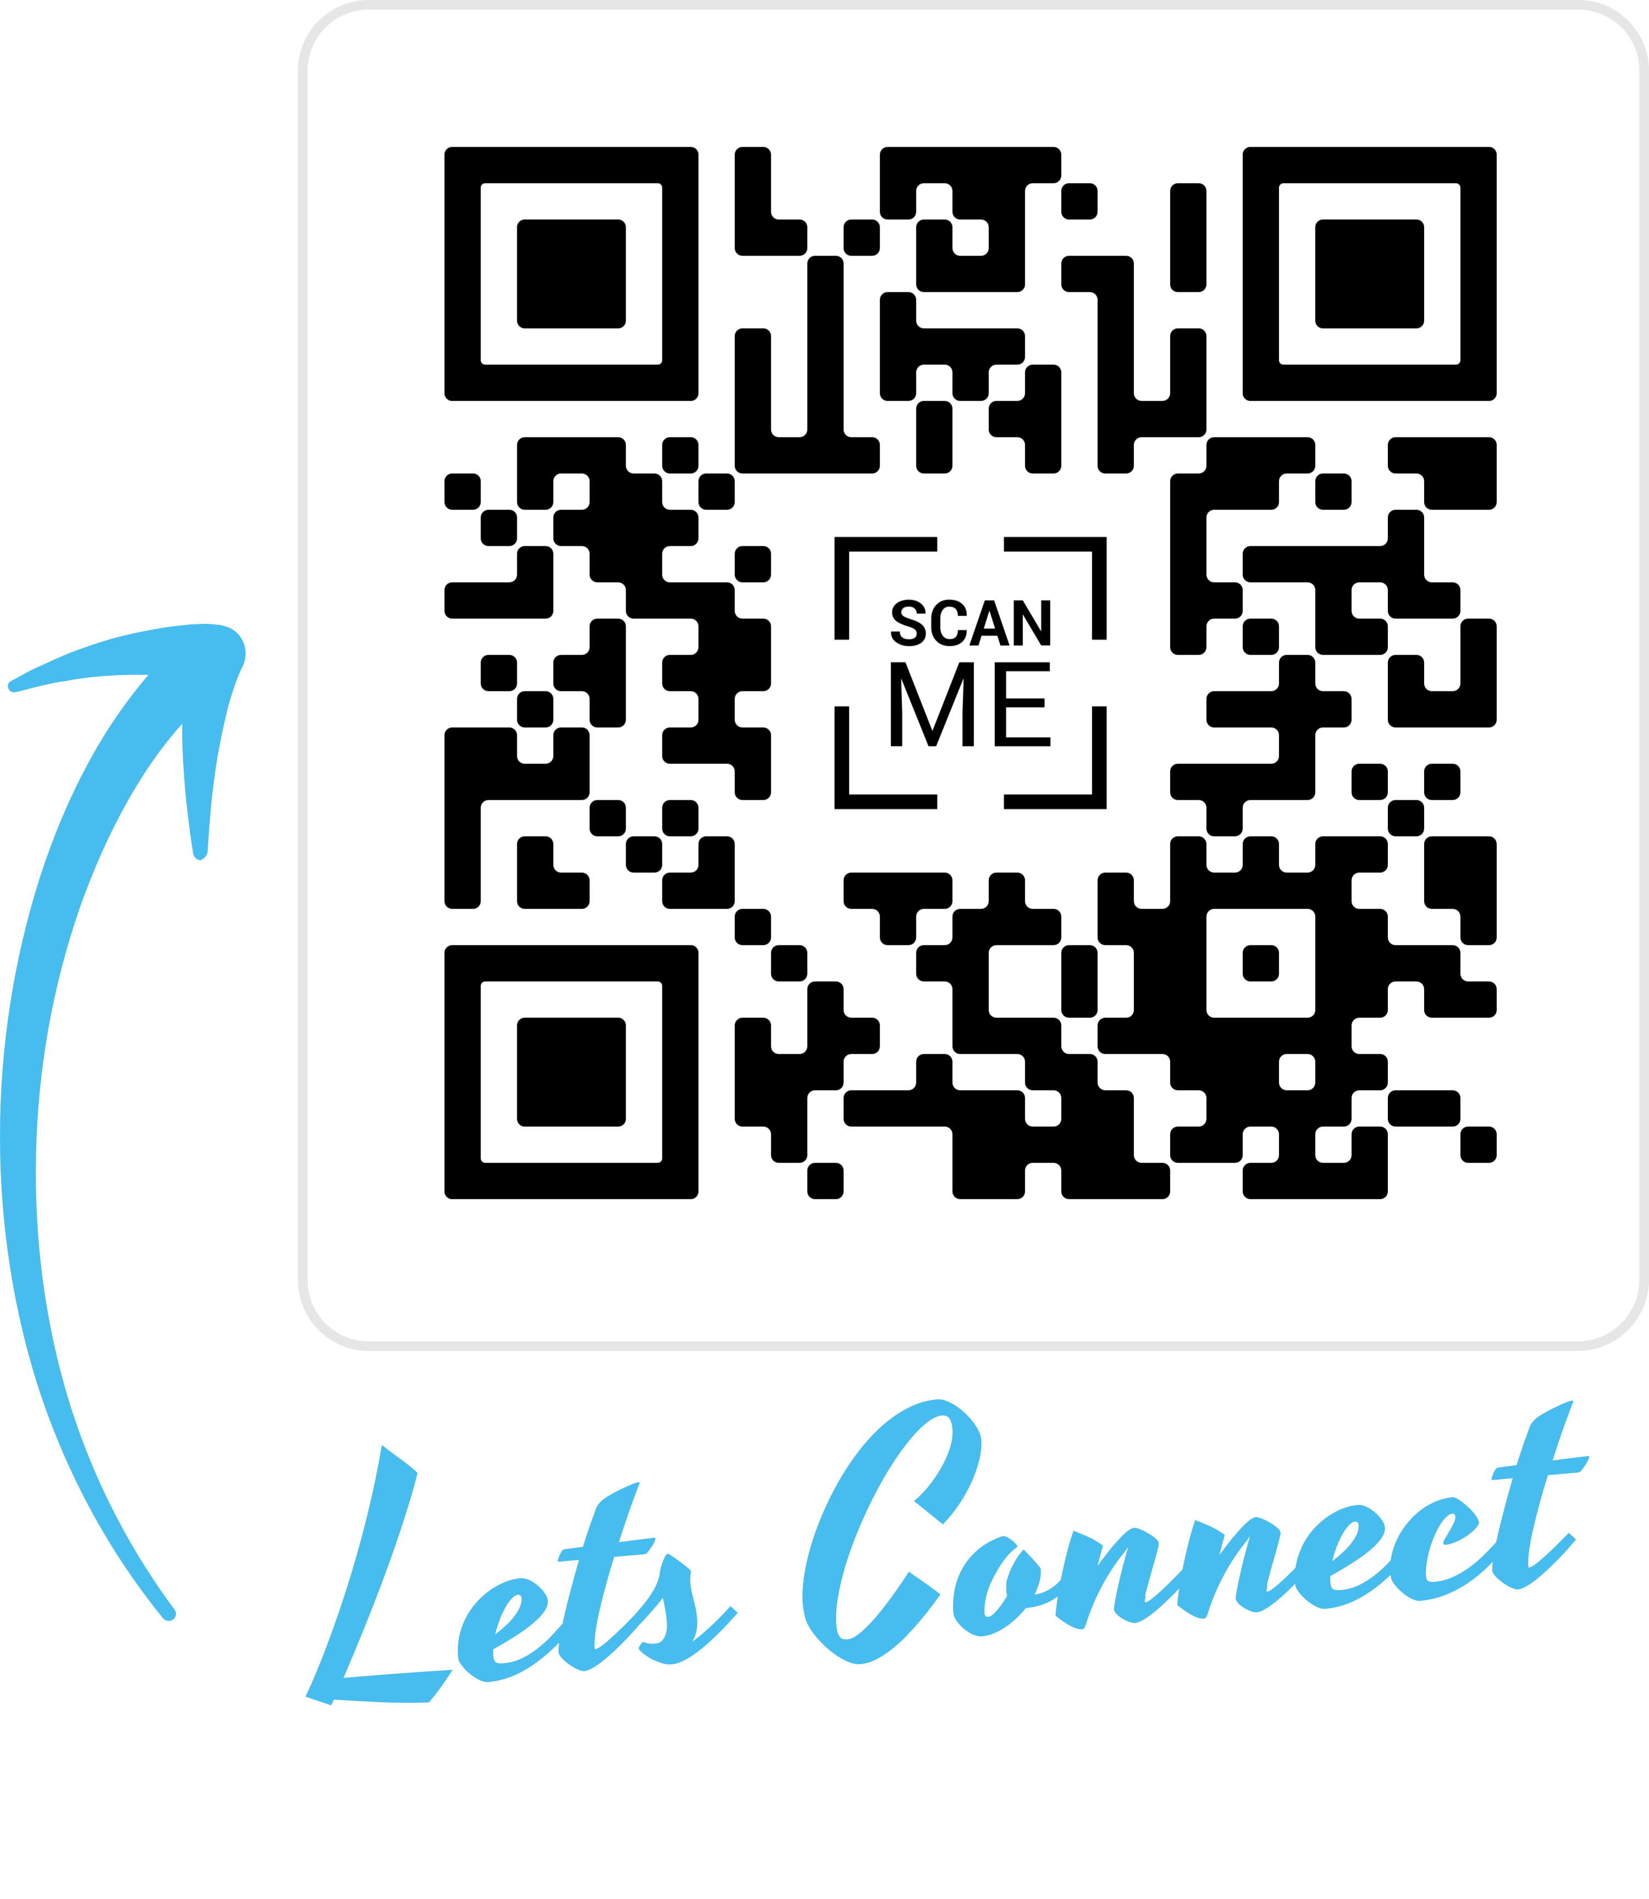
DevOpsDays Nairobi 2024
Notes:
https://qrco.de/bf6NTQ
I have a full detailed article based on this talk. And I normally write more about interesting concepts in tech.
The above QR code links to the article blog link.
Also, If you would love to connect with me, I’m active on X and LinkedIn, on the QR code we have more links to my twitter page and Linkedin. I will give like 10 seconds for that then I will be taking questions after that.

Slide 9

2024
Notes:
Q/A
Thank you for being an amazing audience.

